Slide 1
“Your Amazing Research Topic”
Presented By : Your Good Name
Research Supervisor: Dr. Stephen Hawking

Slide 2
CONTENTS
Introduction
Methodology
Objectives
Results and Discussion
Conclusion
Future Recommendations

Slide 3
GLAUCOMA
- Irreversible damage to optic nerve
- Progressive
- Loss of peripheral vision
POAG
Types
PACG

Slide 4
FREQUENCY of OCULAR ANOMALIES

Slide 5
PATHOGENESIS
hypertension
Death of retinal ganglion cells (RGCs)
Optic Nerve Damage
Vascular abnormalities
Genetics
Damage to trabecular meshwork

Slide 6
OBJECTIVES
Objective 1
2. Objective 2

Slide 7
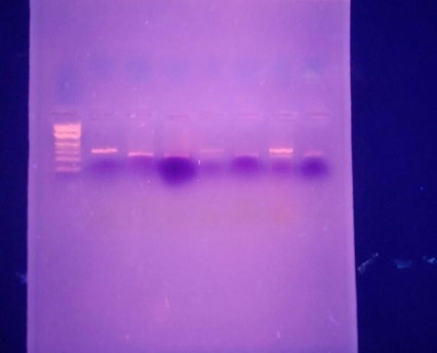
STUDY DESIGN
A
1
2
B

Slide 8
RESULTS
Objective 1
Objective 2

Slide 9
OBJECTIVE 1
Genotyping
Gene 1
Gene 2
RFLP
ARMS-PCR

Slide 10
Total Samples N= 340
Controls = 190
Cases = 150

Slide 11
Conclusion

Slide 12
Future Recommendations
Studies targeting different ethnic groups should be carried out.
Molecular pathways and genes
Hypertension
Formation of trabecular meshwork
Secretion of aqueous humor
Ciliary muscle

